Slide 1
Data and AI

Slide 2
Need to use AI tools
Technology like ChatGPT, Google Gemini, and other Artificial Intelligence tools allow you to complete tasks that used to take hours in a matter of minutes, making it a total game changer
Reasons to learn AI tools:
Improve your performance & efficiency
Automate routine, low-value tasks
Spend more time on the higher value activities
Use AI as an easy way to check your work
Leverage it for learning and answering quick questions
Stay on the cutting edge and competitive in your field

Slide 3
Are Data Analyst Jobs at risk?
companies will always need human talent and intuition, but the skills required to be an effective analyst will shift substantially
Strategic Thinking
Communication Skills
Technical Proficiency

Slide 4
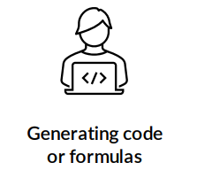
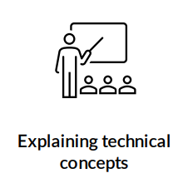
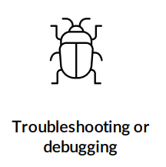
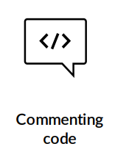
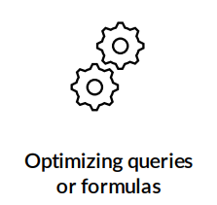
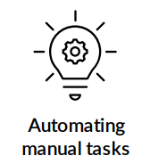
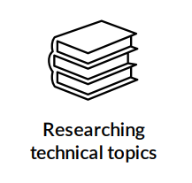
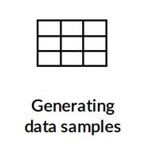
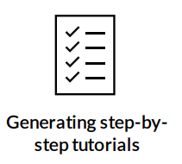
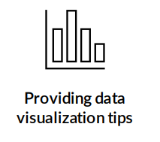
Common Analytics Use Cases

Slide 5
AI Landscape
Artificial Intelligence
Machines and computer systems that mimic functions associated with human intelligence like decision making, image recognition, etc.
Machine Learning
Statistical models that help computers learn with minimal human instruction, and get more accurate when exposed to more data
Deep Learning
Complex algorithms designed to mimic the human brain and learn almost exclusively without human intervention
Large language models (LLMs) fall in this category

Slide 6
AI Landscape
“Week” vs “Strong” Artificial Intelligence
Weak AI (Current State)
Can only perform specialized tasks
Example - GPT-4 could tell you how to drive a car, but couldn’t use that knowledge to drive a car itself
Strong AI (Artificial General Intelligence)
Can learn and perform any task that a human can do
Its development is still on the horizon

Slide 7
Generative AI & LLMs
Generative AI systems are deep learning models capable of generating original text, images and other types of media in response to user prompts.
Large Language Models (LLMs) are generative AI models focused on producing text outputs specifically
Other generative AI models include DALL-E and Midjourney, which are used to generate images.

Slide 8
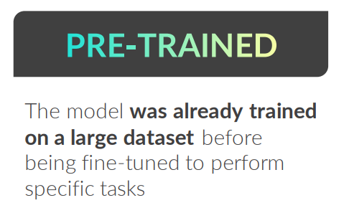
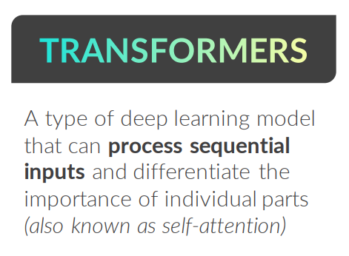
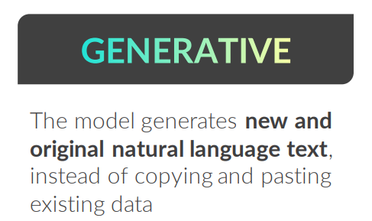
GENERATIVE PRE-TRAINED TRANSFORMERS
Generative Pre-Trained Transformers (GPTs) are a type of large language model trained on massive text datasets and are designed to generate outputs that mimic human-writen text.

Slide 9
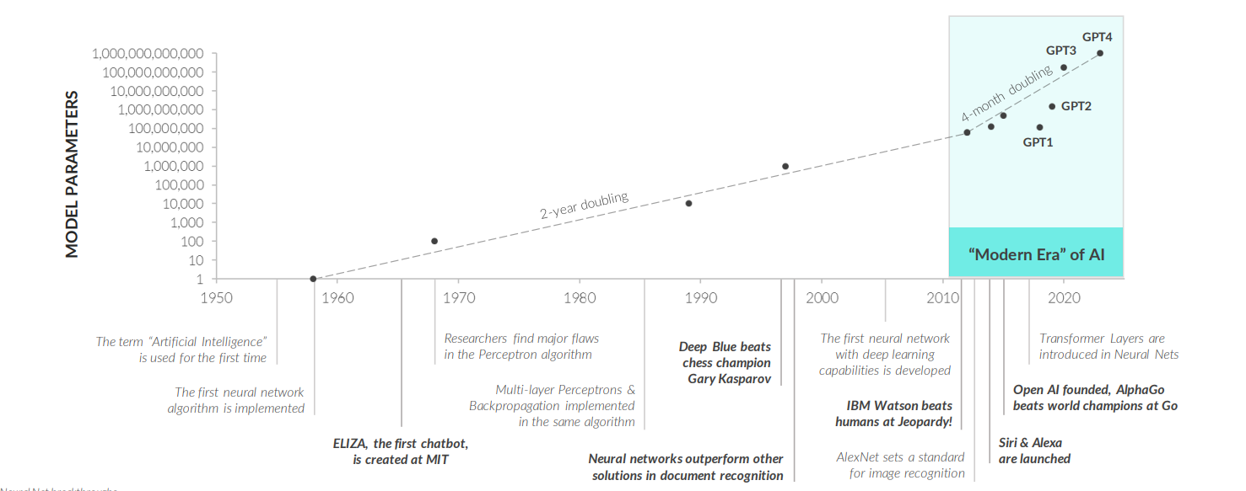
Brief History of AI
AI tools like ChatGPT became widely popular in late 2022, the success is due to more than 60 years of research and development in artificial intelligence systems.

Slide 10
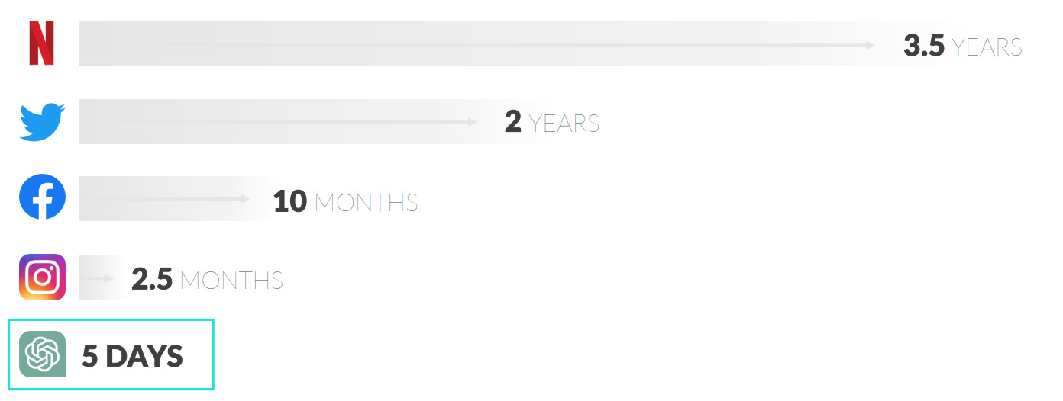
Path to 1 Million
The rate of adoption for modern AI tools is unprecedented; ChatGPT became the fastest growing online product in history, reaching 1 million users in only 5 days

Slide 11
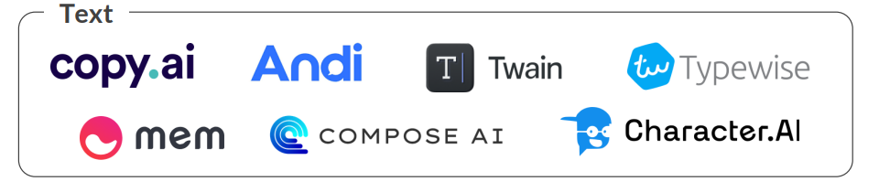

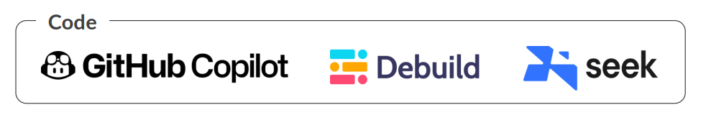
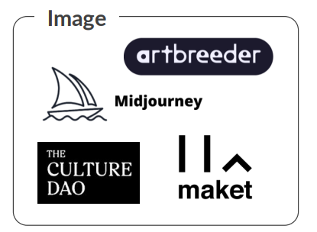
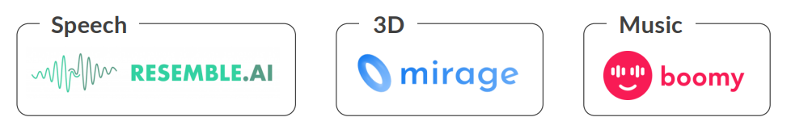
Common AI tools
The rate of adoption for modern AI tools is unprecedented; ChatGPT became the fastest growing online product in history, reaching 1 million users in only 5 days

Slide 12

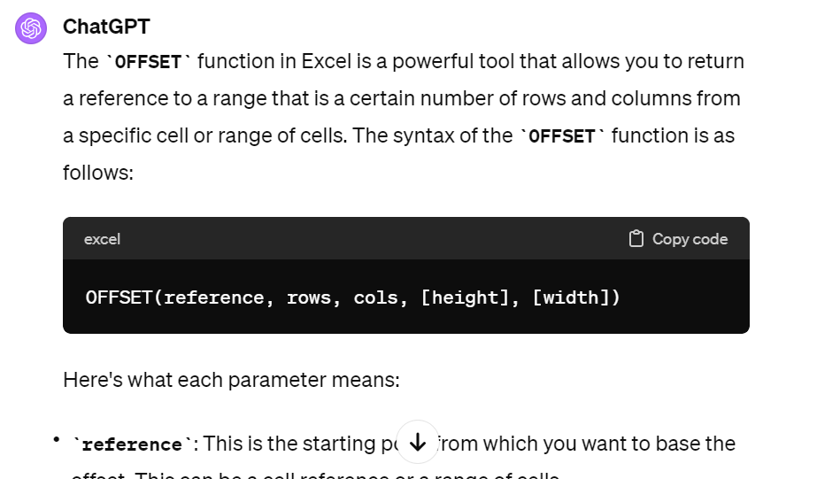
Prompt Engineering
Prompts are questions or instructions that serve as the input for models like ChatGPT
Prompt engineering is the practice of constructing prompts to generate effective and accurate responses
Tips & Best Practices:
Be as clear and specific as possible
Provide context and examples
Establish roles for specific use cases
Set the tone or level of complexity
Understand model limitations

Slide 13


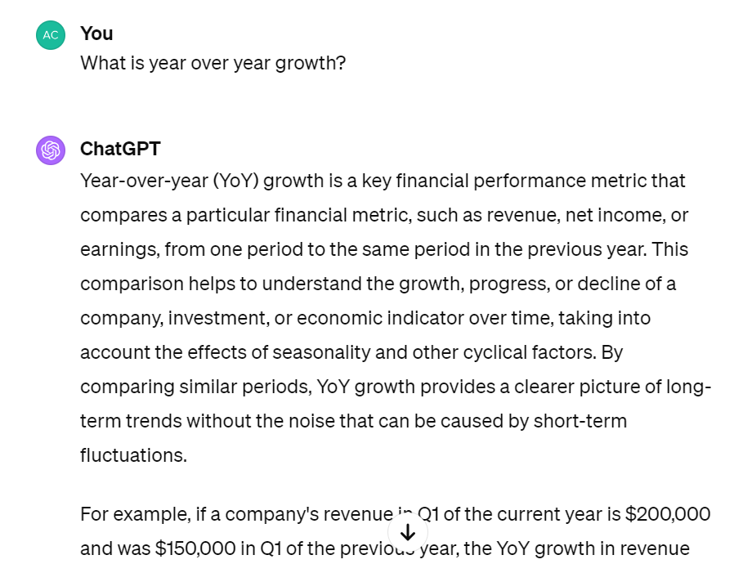
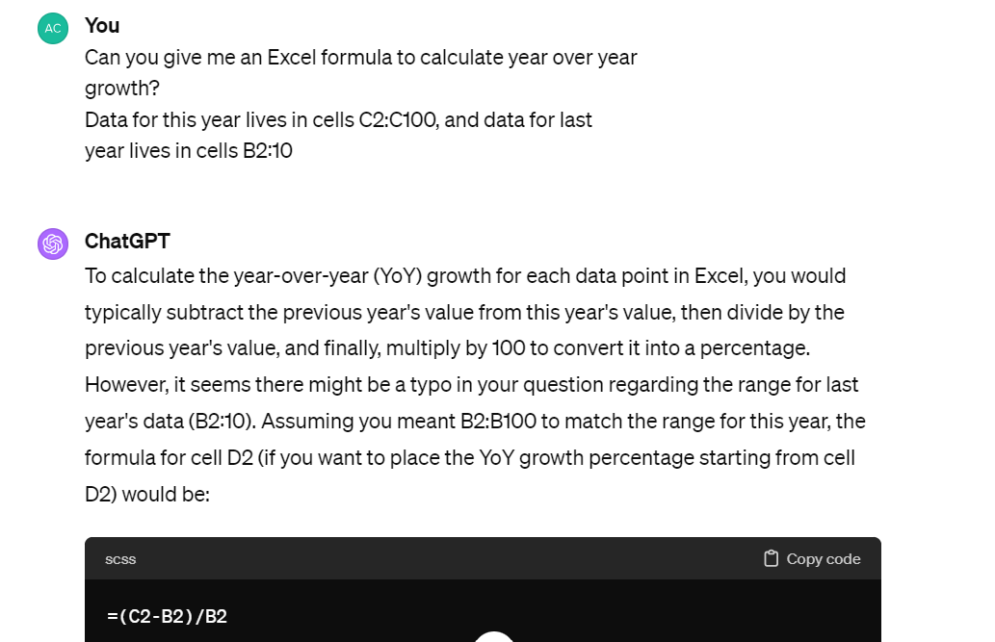
Be Clear & Specific

Slide 14
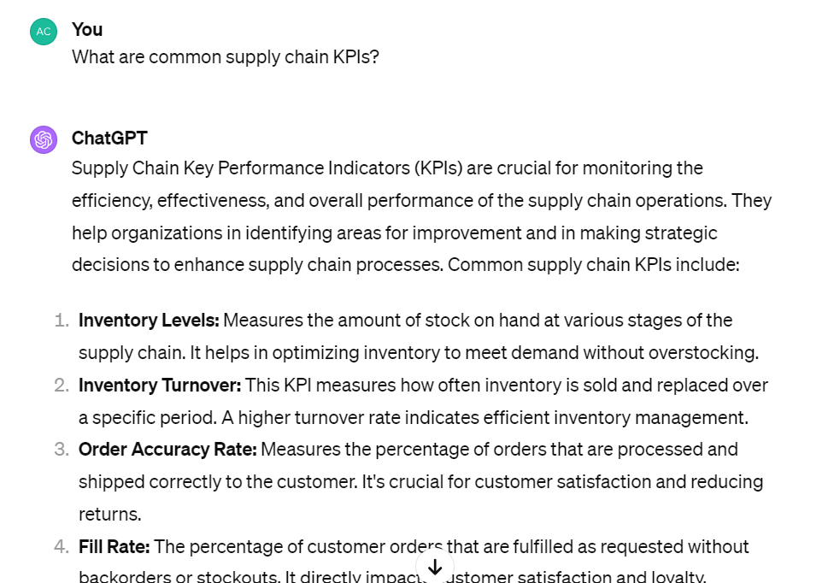
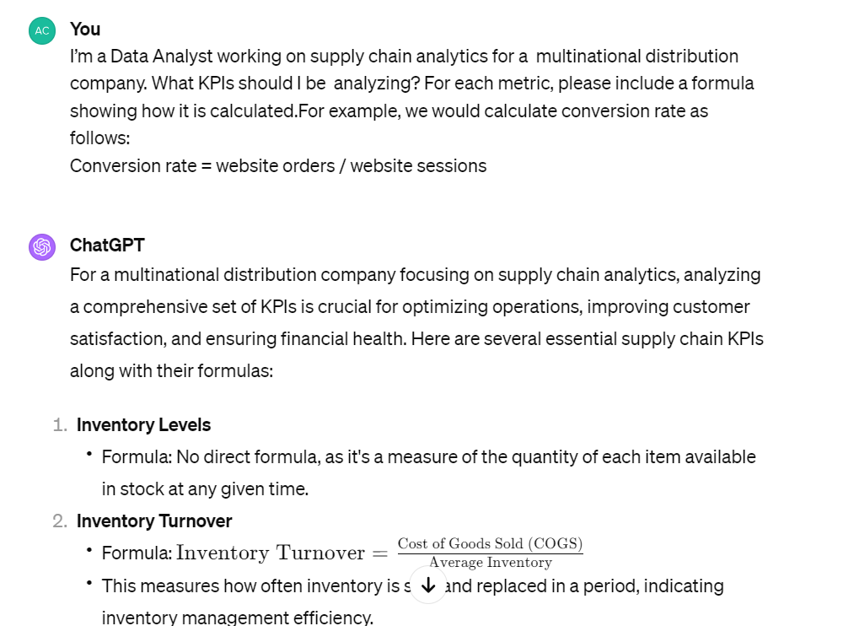
Provide Context

Slide 15
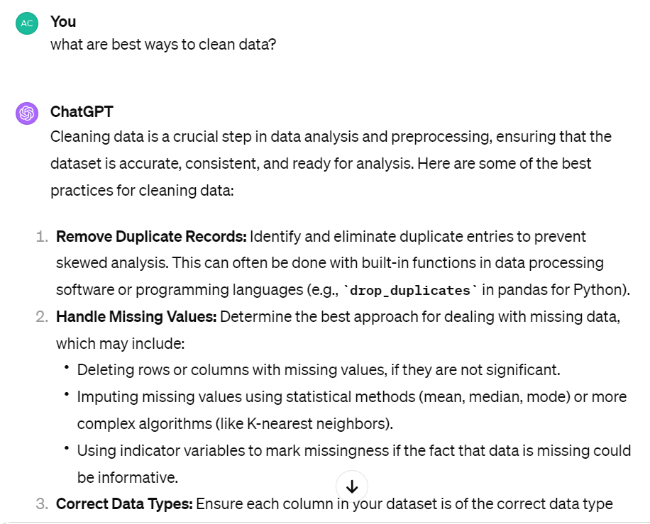
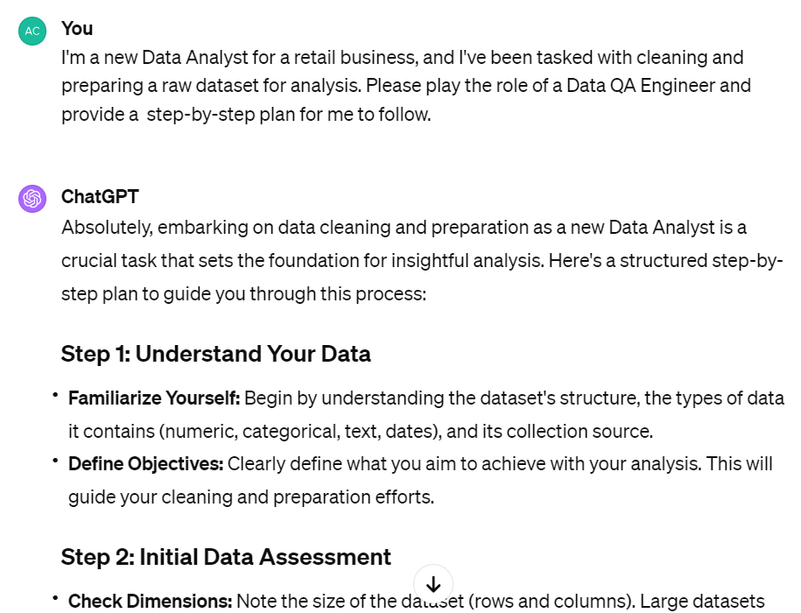
Establish Roles

Slide 16
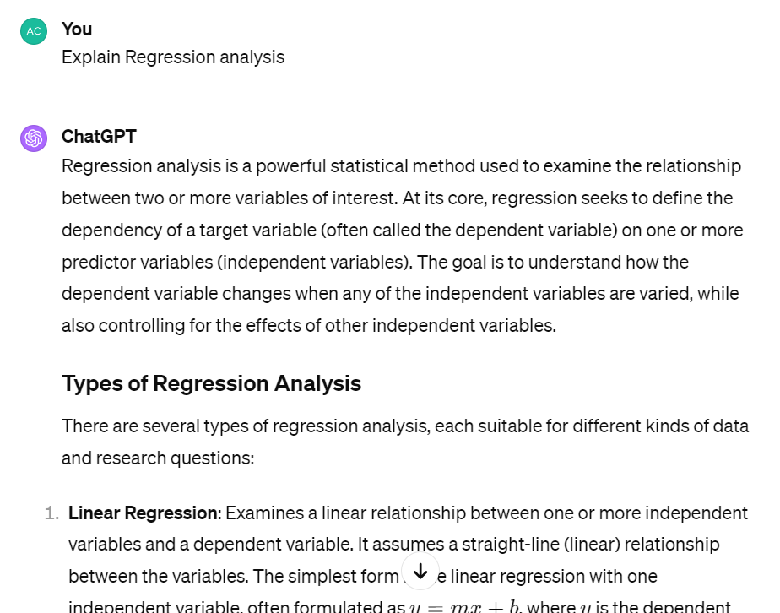
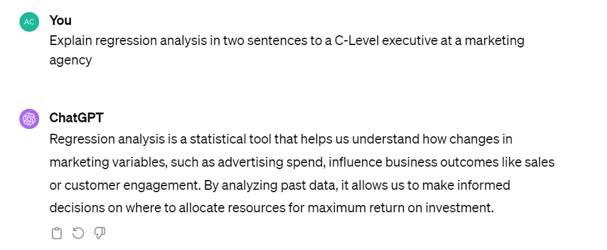
Set the Tone

